Slide 1
Diffie Hellman Key Exchange

Slide 2
Discrete Logarithm

Slide 4
Primitive Roots

Slide 5
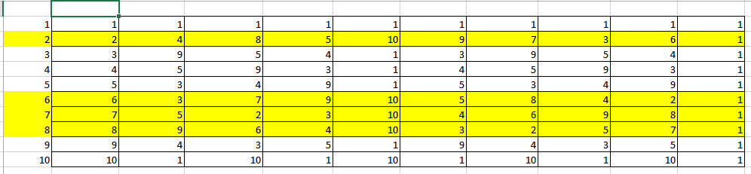

Slide 7
Diffie Hellman key Exchange Algorithm
Diffie-Hellman (DH), also known as an exponential key exchange, was published in 1976.
DH key exchange is a key exchange protocol that allows the sender and receiver to communicate over a public channel to establish a mutual secret without being transmitted over the internet.
DH securely generates a unique session key for encryption and decryption that has the additional property of forwarding secrecy.

Slide 8
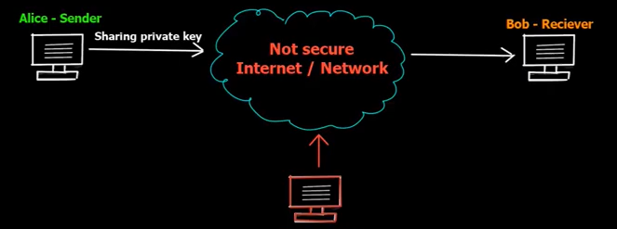

Slide 9
Algorithm
Two parties can agree on a symmetric key using this technique.
This can then be use for encryption / decryption.
This algorithm can be used only for key agreement, but not for encryption or decryption.
It is based on mathematical principles

Slide 12
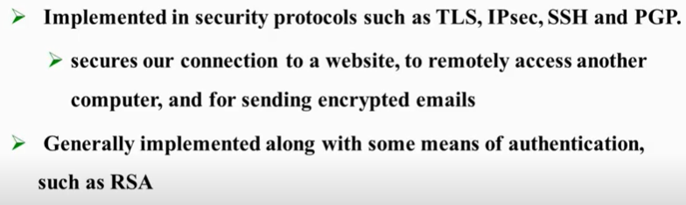
Diffie Hellman key exchange in real time

